Slide 1
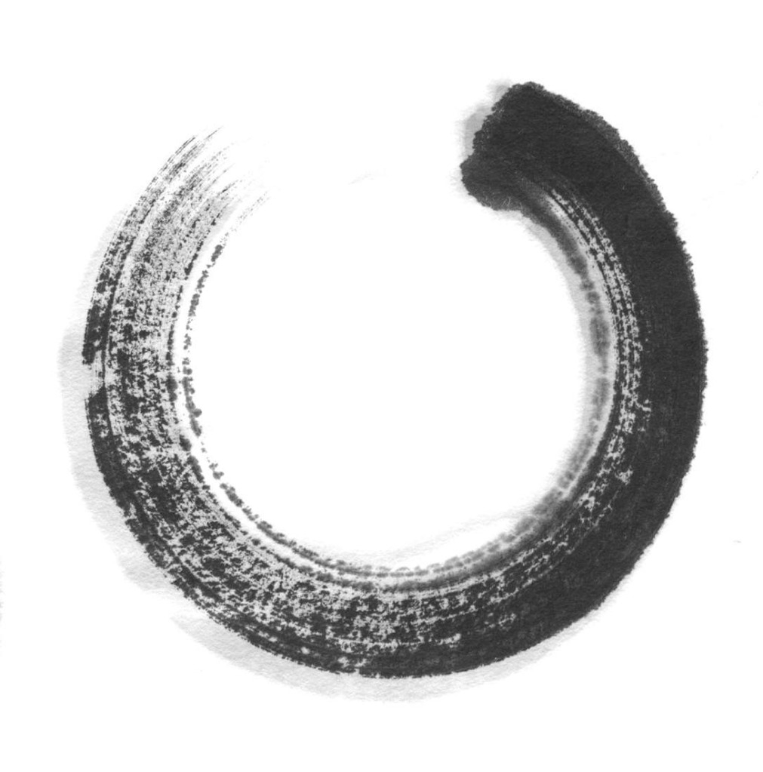

蒙古国立教育大学
孔子课堂
Confucius Classroom
At MUSE

Slide 2

Outline发言要点
I. Ceremony of Unveiling the Nameplate;
揭牌仪式
II. Status in quo；
课堂基本情况
III. 2011年1—5月中旬的工作；
Activities Conducted in 2011
HSK Seminar
Cultural Salons
HSK Courses

Slide 3
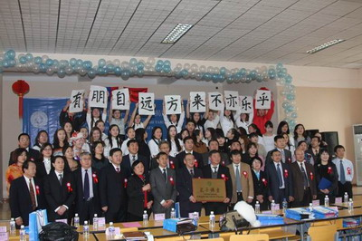
I. Ceremony of Unveiling Nameplate

Slide 4
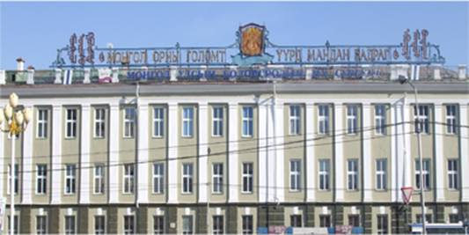
Time: Dec 20th, 2010
Place: the Mongolian State University of Education(SMUE),Ulan Bator

Slide 5
Vips Present
Reps from China’s Embassy:
Yu Hongyao,Ambassador,
Wu Xinying,Counsellor,
De Bo,First-class Secretary;
Reps from MSUE:
B.Jadambaa, President, B.Purev-Ochir and A.Tsog-ochir,Vice Presidents,

Slide 6
Vips Present
Reps from NENU:
Zhang Shaojie, Vice President,
Zhao Junfeng, Director,
Zheng Guo’ai,Director,
Li Miandong, Director,
Sun Desheng, Section Chief

Slide 7
Vips Present
Reps from Media:
Xinhua News Agency (Ulan Bator),
People’s Daily(Ulan Bator),
Mongolian News Daily.

Slide 8
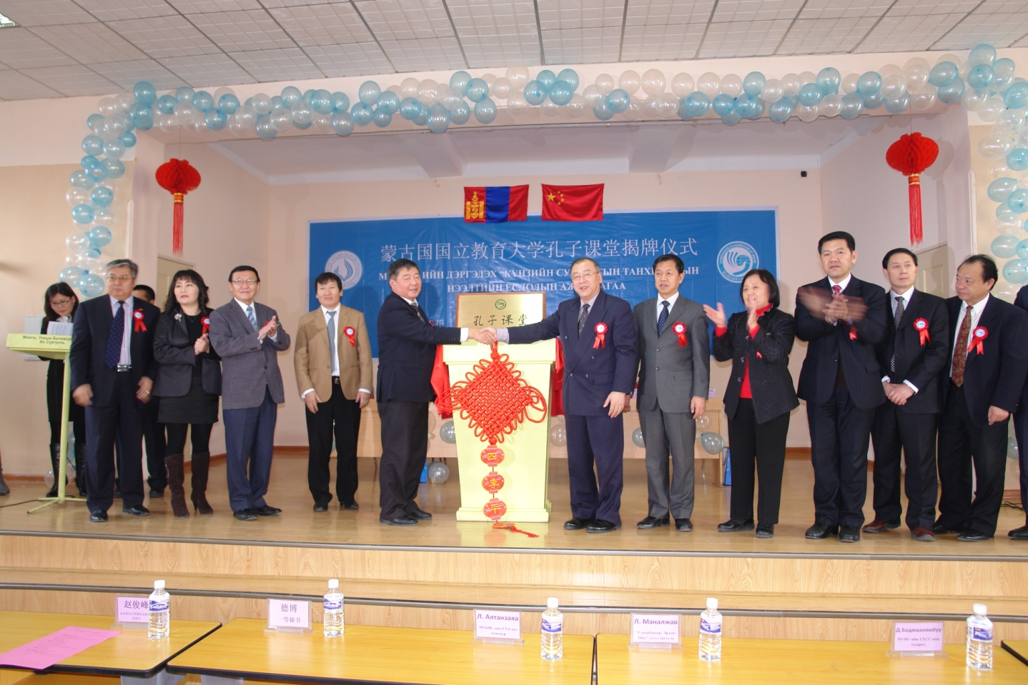
Ceremony chaired by Yu Hongyao and Jadambaa and accompanied by Zhang Shaojie,Wu Xinying,Zhao Junfeng, Zheng Guo’ai,Li Miandong, B.Purev-Ochir,A.Tsog-Ochir,Tsogzolmaa and De Bo.

Slide 9
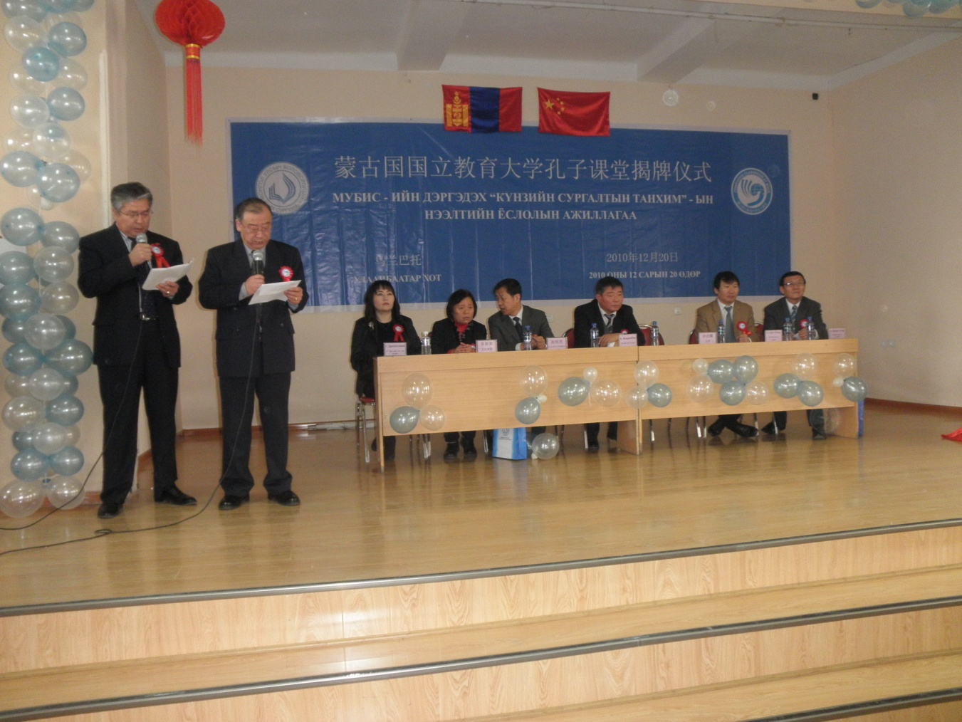
Yu Hongyao

Slide 10
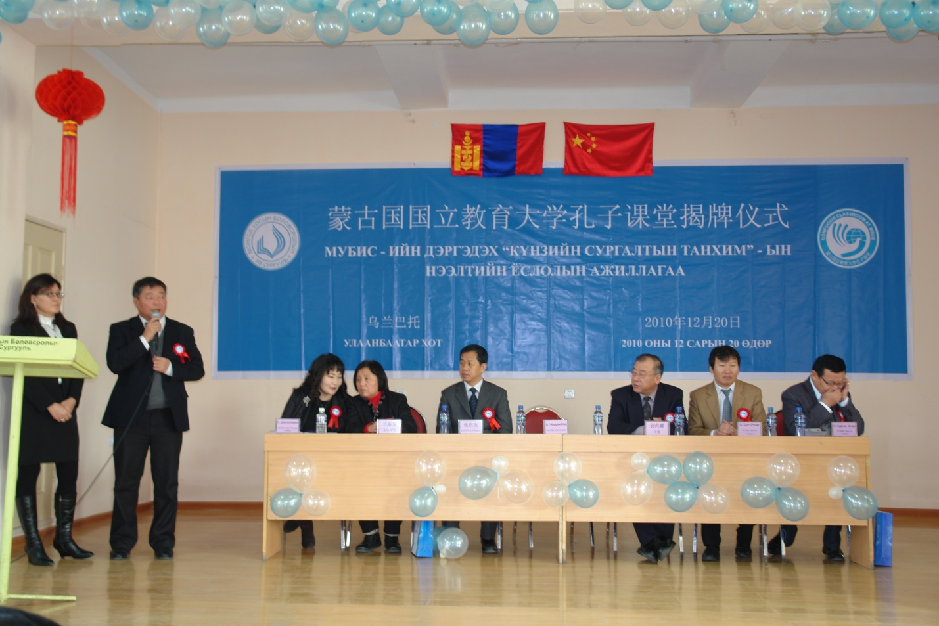
B·Jadambaa

Slide 11
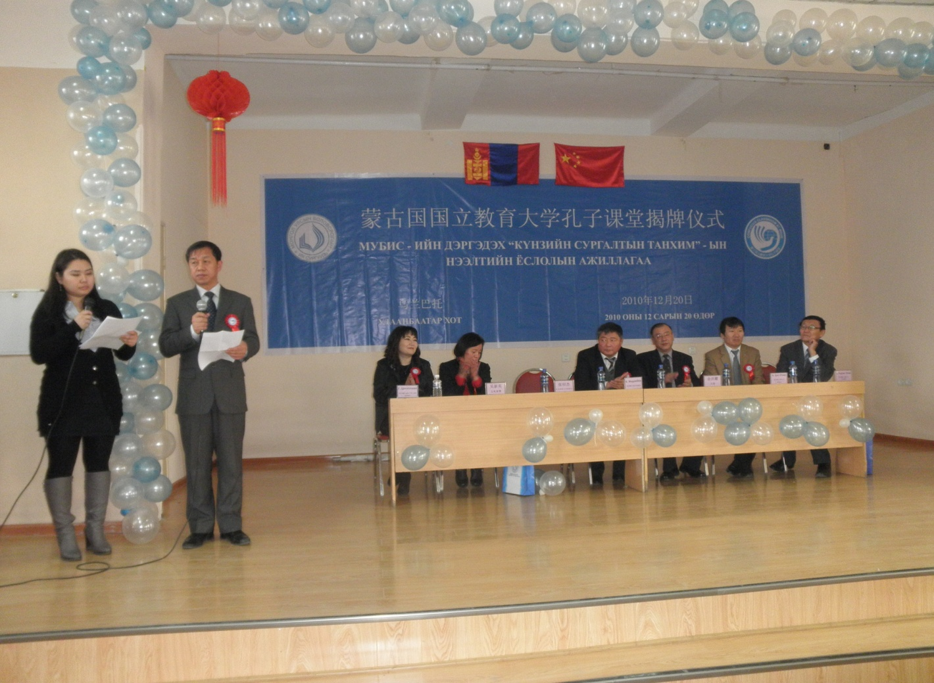
Zhang Shaojie

Slide 12
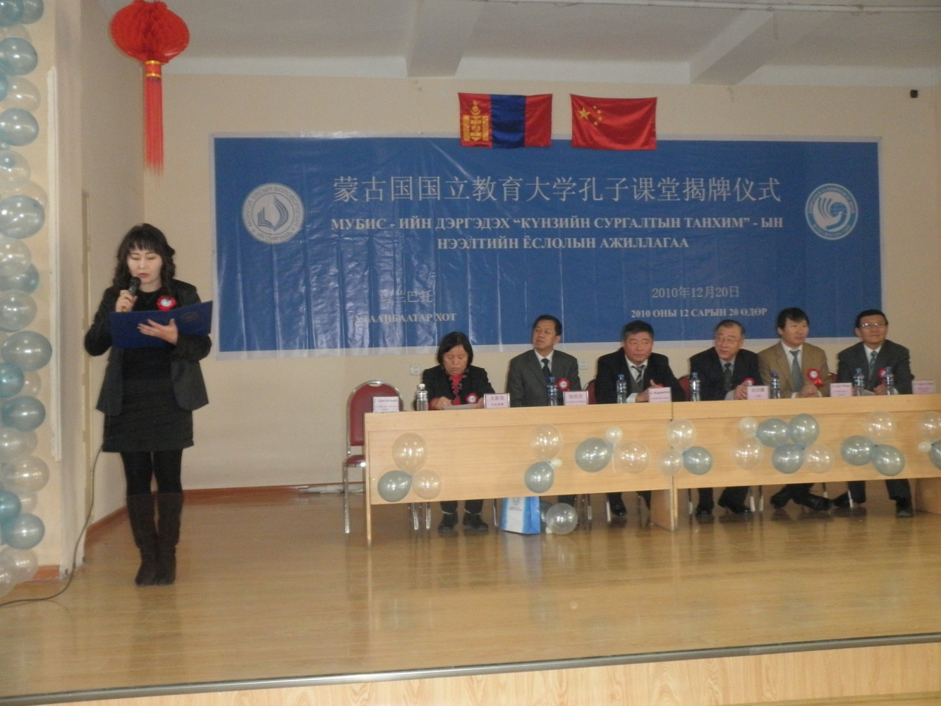
G· Tsogzolmaa

Slide 13

II. Our Confucius Classroom
A multimedia classroom

Slide 14
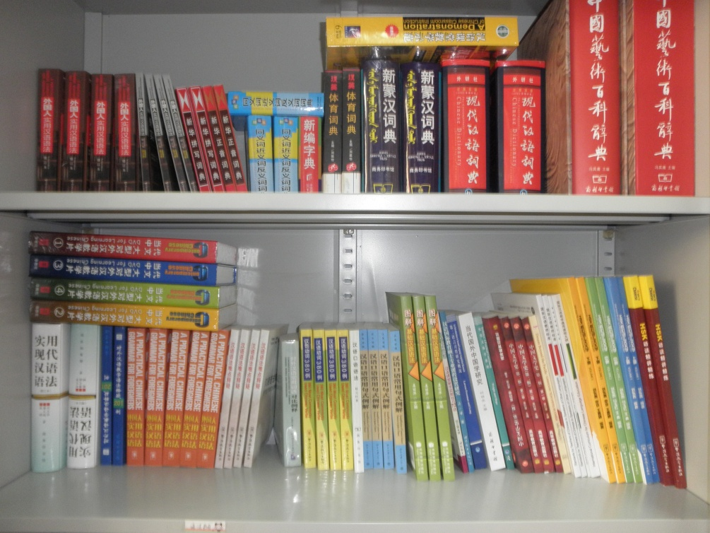
1,200 Books

Slide 15
III. Activities
Conducted in 2011
1. HSK Seminar
2. Cultural Salon
3. HSK Stimulating
Course

Slide 16
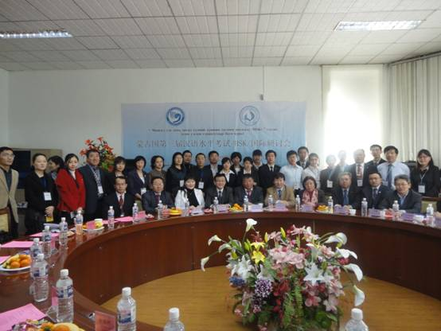
1. The Third Mongolian HSK Seminar

Slide 17
Time: Mar. 27th, 2011;
Place：MSUE;
Experts Present：
Over 40 expertise Chinese and Mongolian teachers engaged in education and research of the Chinese language;
Papers received：Over 20;
Sponsored by: China’s Embassy;

Slide 18
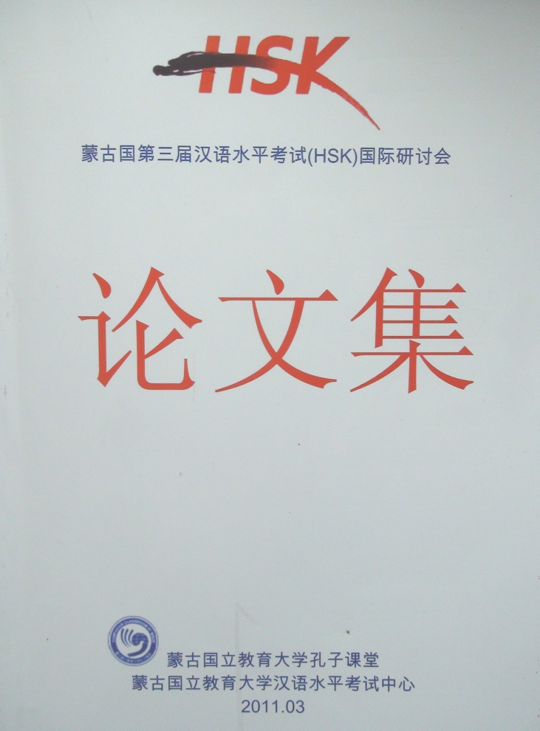
Collection of Papers to be published

Slide 19
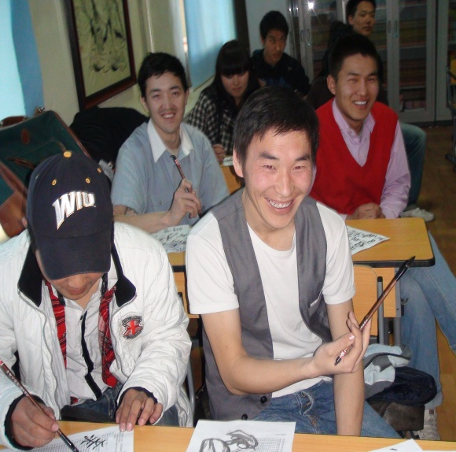
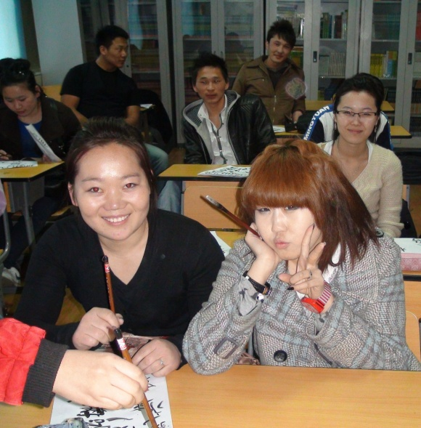

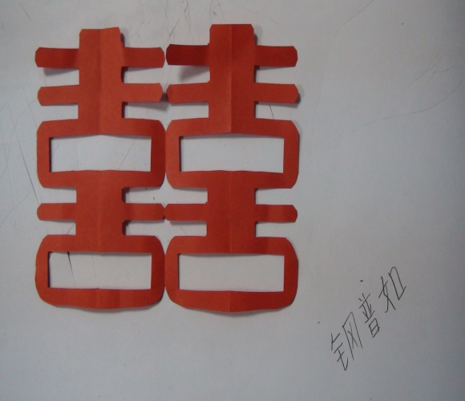
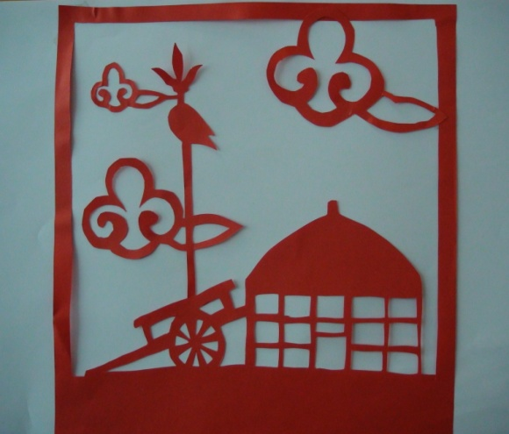
2. Chinese-Culture-oriented Salon

Slide 20
Details
Time: weekends from March to April
Place：our classroom
Participants: students of all levels from MUSE and other schools
Number of Participants: 150 or so
Number of Salons：15
Types of Activities：lectures，workshops, personal experiences, movies,etc

Slide 21
3. HSK Stimulating Courses
Number of Classes: 4
Class Hours: 180 or so
Levels of Classes: Bands 3,4,5 and 6
Types of Students:
middle school students, college students,
technicians, teachers,etc

Slide 22
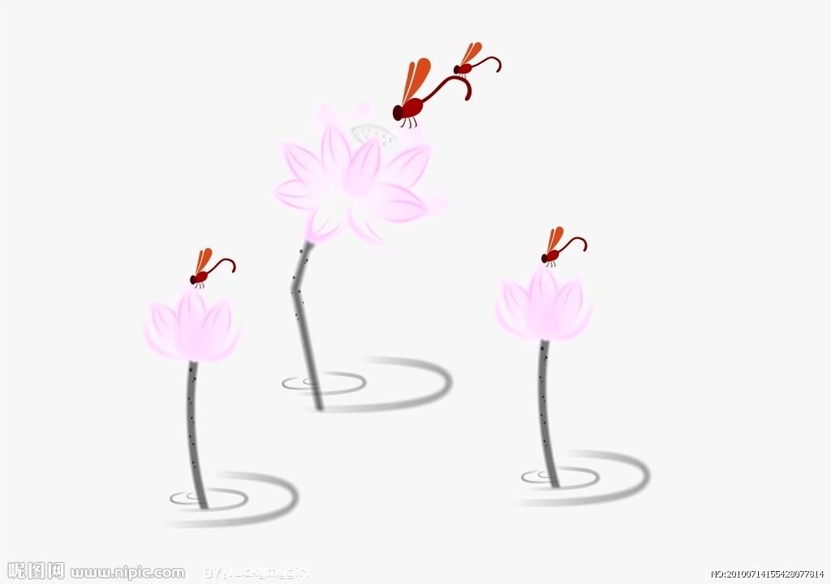
Thanks very much!
Thanks very much!

