Slide 1
Using a mobile app (plickers) as a tool for formative assessment
Bolormaa Batsuuri, Altantsetseg Chimedtseren MNUE
TEFL conference 2016

Slide 2
Discussion questions
Why do we assess students’ learning?
Do you use any mobile app for your lesson?
What is Plickers?
It’s a device
It’s an assessment tool
It’s a mobile phone
It’s a web-based lesson

Slide 3
Why do we assess students’ learning
To compare with
To see/examine if students meet a particular standards
To help the student’s learning
To check if the teaching program doing it’s job

Slide 4
What is Plickers?
Plickers is :
a web-based formative assessment tool

Slide 5
How to use :
Steps:
Print your cards
Download the app Plickers on android device
Create a Plickers account at www.plickers.com
Create/add and manage classes
Plan/create questions
Scan responses
Immediate feedback with live view
Add your questions

Slide 6

How does it work?
1. Print cards on white paper or cardstock
2. Each student receives a special coding card with the letters A-D printed on each side.

Slide 7
How does it work?
The code has 4 sides, each lettered A,B,C, and D.
The students holds the card so that the letter they choose to answer the question with is at the top of their card.

Slide 8
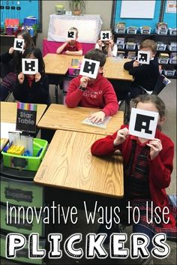
The student responds to a question by raising the card in the air with the appropriate letter held towards the top.

Slide 9
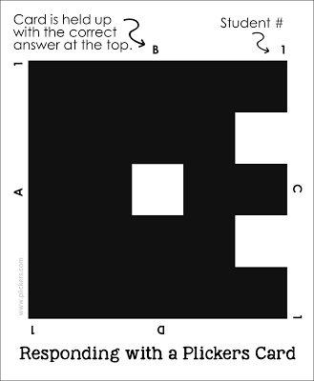
Why smaller font for the standard cards?
To have the most accurate data possible about what students do and don’t know
Want students to feel comfortable answering honestly
No cheating

Slide 10
Plickers rules
Hold the letter you think correct is on top
Don’t say your answer out loud
No bending or waving the cards in the air
If the card is not being used place it face down in front of you

Slide 11
To Create a Class
Go to www.plickers.com and sign in using the same user ID that you use for the mobile app
Click Classes at the top left and select (+Add a new class)
Enter student names. Plickers will automatically assign each student a unique card number so you can review individual student data for your questions.

Slide 12
To Begin Assessing / Polling
Login to your account Both online and on your mobile app
On your mobile device (in the app):
Choose the class you wish to assess
2. Click the question you wish to display via projector

Slide 13
Scanning responses
The teacher uses the Android app on their smartphone or tablet to slowly scan the room.
The app recognizes the cards, records who the teacher assigned them to, and captures the answer that the student chose.
As the cards are displayed, the teacher scans the room using a smart device.
Each answer is recorded and the data

Slide 14
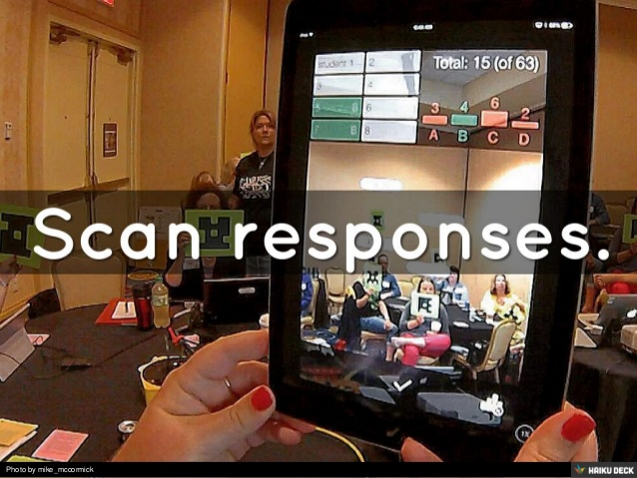
Scanning responses

Slide 15
On your Computer Screen:
Click the live view tab in the upper left corner
The question you’ve selected in the mobile app should be displayed on the screen
If you select GRAPH VIEW by clicking the arrow on the right side of the screen students will be able to see the answers populate as you scan around the room

Slide 16
Advantages
T
Easy setup and use
Help to protect students’ privacy
Professional development (It also allows teachers to reflect on their pedagogical practice based on the data.)
Real-time data from responses (You get quick data from your students to find out what they know and don’t know)
Time –saver: Fast, Organizes data automatically, (Immediate feedback)

Slide 17
Advantages
Engage all (Student participation is high and Data tracking).
Student could use the same card all year.
Easy way to integrate technology into the classroom
Fun and free
No batteries to lose or replace, no expensive equipment to buy and no one left out.
Take attendance (At the start of the class have them hold the cards to check-in)

Slide 18
Weaknesses
Cards must be printed and laminated to get plenty of use, however you can always print a new card for free.
Limited to multiple choice questions.
Type the questions and answers manually

Slide 19
Things to consider:
Scanning wrong answers
Make sure your device is upright (portrait orientation) while scanning, otherwise if on it’s side (landscape orientation), the camera will read the cards incorrectly.
Cards not scanning:
Lightning
Glare
Distance: (The standard size will scan optimally from 6-15ft)
Tip: Encourage students to hold their cards by the edges so their fingers aren’t accidentally covering the Plickers code

Slide 20
Suggested ways to make the cards durable
You can also laminate the cards to make them more durable
But glossy lamination creates glare on the cards that can make them difficult for the app to read as quickly
Another way you can make them more durable is to have students paste them onto the inside cover of a notebook ;

Slide 21
Conclusion: Simple Ways to Use Plickers as an assessment tool
Three assessment strategies :
Assessing Prior Knowledge
Ongoing Formative Assessment
Easy Digital Exit Tickets

Slide 22
Comments of some users
"The kids love it. I thought of it as a good data-collection tool, but my high school kids think it's a game."
- Susan Clark Russo, Math teacher
“They LOVE this!! It is super fun for them and the engagement during those quizzes is stellar.”
–Holly Dent Science teacher
T. Robinson-Freeman says
February 26, 2016 at 12:55 am
I’ve heard about Plickers, I have not had the opportunity to use them. I am all in for any technology that prevents me from using pencil and paper. Save the trees :).

Slide 23
Resources
Evaluating your students Andy Baxter (2001)
Assessing speaking in the EFL classroom http:www.scribd.com/doc
Technology and the teaching of oral skills. CATESOL Journal, Chan, M. (2003)
www.http://plickers.com
Hints and tips-google search
Plickers youtube.com

Slide 24

Thank you for attention

