Slide 1
Using “Dialogue Journal”-in foreign language teaching
Bud Odon
Ankhzaya Batsuuri
Apr.18.2013
Notes:
As teachers, our purpose is not only to educate our students, but also to foster them to be humane and matured. For this reason, it is critical for us to build close and open fellowship with our students. Unfortunately, because of our heavy workload, we do not always find time to talk to each student freely, on the other hand, the students also are vulnerable to initiate the talk.
So, we believe that by using Dialogue Journal, we will be able to communicate each student personally.

Slide 2
To introduce “Dialogue Journal” to the teachers and encourage them to adopt it in their teaching.
Goal

Slide 3
Questionnaire
1
2
3
Do you wish to have closer relationship with your students and have mutual understanding?
Have you ever communicated with your students through any kind of journaling before?
Do you use “Dialogue Journal” in your teaching?
Notes:
I’ve got a mini questionnaire of from 20 teachers who teach English, Russian, Japanese, Chinese and Korean at MSUE. Those teachers have been working as teachers for 2 months – 20 years.
Q 1: 100% Yes. What way? Talking
Q 2: No
Q 3: No
Тэгвэл “Dialogue Journal” нь дээрх асуудлыг шийдвэрлэх үр дүнтэй арга замын нэг төдийгүй оюутнуудын гадаад хэл дээр бичих, унших, ярих чадварыг дээшлүүлэх давхар ач холбогдолтой юм.

Slide 4
WHAT IS A ‘Dialogue Journal’?
1
‘Dialogue Journal’ is a conversation journal between a teacher and an individual student. The communication is held informally under any topics of mutually interested.
Notes:
Extra talk about dialogue journal

Slide 5
WHAT IS A ‘Dialogue Journal’?
Dialogue Journal was first introduced by a 6th grade teacher Leslee Reed from LA in 90s. Since that time this method has been used for elementary, secondary, higher education and also immigrant trainings.
The result is guaranteed.

Slide 6


LISTENING
READING
SPEAKING
WRITING
Four skills of a foreign language
Notes:
The latter 2 skills are considered as Productive Skill. That’s why it is hard to develop the productive skill.
Therefore, it is very effective for improving reading, writing and even speaking skills.

Slide 7

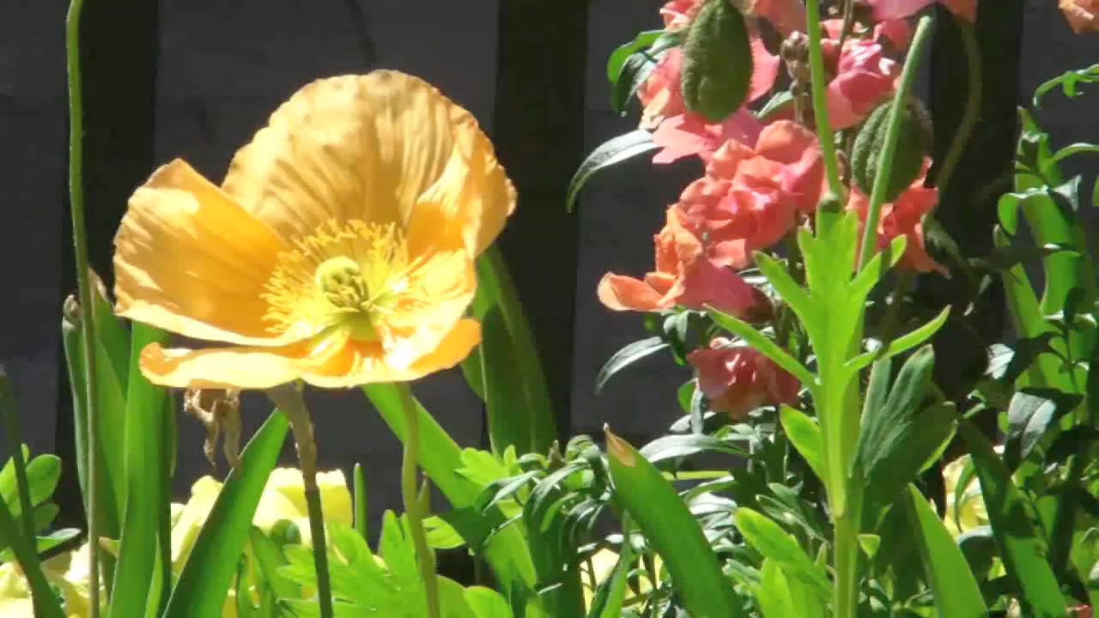
Sample
Student’s writing:
I hve a dog. have
Hz nam is Skardy Hair. Scaredy
He ets meet. eats meat
Teacher’s response:
I like the name Scaredy Hair. How did you pick his name? I have a dog too. Her name is Pixie. Pixie likes meat too. What do you like to do with Scaredy Hair? I like to go for walks with Pixie.
Notes:
HAAIS-iin jisheen deer yarih mal emnelgiin angiin oyutnuud.
Odoo mon ooriin hicheel ordog angiuddaa ashiglaj ehelj bgaa.
Эхний үед суралцагчид өгөгдсөн асуулт, сэдвийн хүрээнд маш энгийн, богино, товч байдлаар буюу 2-3 өгүүлбэрээр хариулах гэж оролддог. Харин харилцах дэвтэрийг тогтмол хөтөлсөнөөр оюутнуудын дээр дурдсан чадварууд мэдэгдэхүйц байдлаар аажмаар нэмэгддэг байна. Өөрөөр хэлбэл тэд удахгүй хагас нүүр цаашилбал бүтэн нүүр хэмжээтэй текст зохион бичиж эхэлдэг.

Slide 8
Sample 2
Andy: today is funny day and my cry day “God please me too good english” “please please God I’m cry boy and dumb boy I’m sorry teacher and I’m a dumb student I’m sorry sorry teacher”
Teacher: Oh! No! you are not a dumb student! You are smart! Every day you learn more. I am so happy because you learn every day. You work hard! You are doing well!

Slide 9





Sample questions
Tell me about your family
What is your ideal life goal?
Why did you choose this occupation?
What is your unforgettable childhood memory?
What is your most favorite film and why?
Whom do you admire the most?
Tell me about your daily routine?
If you have an opportunity, where would you want to travel and why?
If you met a tourist who came to visit MGL, what kind of advice would you like to give him/her?
What is your favorite food and how do you make it?
Notes:
Багш нар өөрийн хичээлийн агуулгын онцлог, суралцагчдынхаа хүсэл сонирхол зэрэг дээр тулгуурлан бичих сэдвийг өөрөө сонгох бүрэн боломжтой.
More advanced and intimate questions can be asked.

Slide 10
Tell me about yourself and your family?
What is your ideal goal?
Tell me about your most favorite movie? Why is it unforgettable to you?
What will your life be like in 15 years of time?
Picture your future house?
What do you want from the teacher?
What are you up to these days? What’s new?
Imagine that you’re in a foreign country and send me a postcard?
How would you like to spend your summer holiday?

Slide 11
Student – Teacher communication example
Mmm, I don’t have parents. I want to live my dreams, they’re gone. A dreams about my life goal. I want to be useful man by others. And I like to say be strong…and keep moving forward…do as a best you can…and forget about your pain…
I’m so sorry to hear about your parents and sorry again for asking. I really like your viewpoint here. It’s very much valuable to try your best and leave the pain behind. Thank you for sharing your precious thoughts. However, I’d like to say that even your dreams are gone, you should have new dreams to live for.

Slide 12
Some of students’ questions?
Have you loved anybody?
What do you think about me?
You advice me about my English skills. For me, please. What do you think about my English?
Please correct my writing mistakes.
Teacher, what is your favorite book?
What do you think about my good behavior and bad behavior?
How should I improve my English skills?

Slide 13
How to write a dialogue journal?
It is considered to be best suited to write on a journal at the end of classes for last 10-15 minutes. Because your students are going to be quite excited about reading what you have written or how you have responded to their writing. Sometimes it distracts their attention to the rest of the class.

Slide 14
How to write a dialogue journal?
It is very important for the teachers to take notes on your journals simultaneously with students. What to write? This is time for the teacher to self-reflect how the class went, what the strengths and weaknesses were, anything to be aware of next time, any new ideas and so on.
Notes:
Mon sts won’t be distracted.
It is also a self-reflection time for teachers

Slide 15
Precautions regarding the Dialogue Journal
Teachers need to think thoroughly when to choose questions to ask. Since the class consists of many students with various backgrounds, ethnic groups, religions, it is critical to avoid any questions that would offend, or insult their beliefs and values or force upon your opinion.
It is important for you teachers to always answer back with cheerful spirit to encourage them to write confidently, bravely and openly.
DO NOT forget to answer questions of your students.
Keep the writing from becoming too personal

Slide 16
Strengths and weaknesses
Increased opportunities for communication between students and teachers.
All students can be involved
You can gain information that can assist in lesson planning
It is much smaller than compositions or essays. Therefore, easy to be read by teachers, would not take much time.
Reading, Writing and speaking skills will be improved.
It gives students opportunity to write freely without making any mistakes or getting bad marks.
It becomes bases of further academic writing.
Takes time.
Hard to maintain writing.
Notes:
If u wanna good result u better be unofficial.
Үүний үр дүнд оюутны хичээл таслалт ч буурах боломжтой.

Slide 17
Conclusion
Dialogue journal can be used by any subject teachers.
Teachers are open to choose conversation or questions based on their subject characteristics, and the students’ interests.
The writing will be not too long therefore, it will not create any pressure on teachers’ work, plus it is very interesting!
Notes:
Actually dialogue journal is the first stage for students to further writing such as any kind of academic writing or essays. (Fulwiler 2000)

Slide 18
What do you think about using Dialogue Journal?
Are you planning to use Dialogue Journal in your classroom?

Slide 19

Reference
“Dialogue journal writing with nonnative English speakers” A handbook for teachers by Joy Kreeft Peyton, Leslee Reed
HIS English Curriculum
http://www.teachervision.fen.com/writing/skill-builder/48885.html
http://www.sil.org/lingualinks/literacy/implementaliteracyprogram/usingadialoguejournal.htm
http://www.ericdigests.org/pre-926/journals.htm
http://www.sil.org/lingualinks/literacy/implementaliteracyprogram/usingadialoguejournal.htm
http://www.google.mn/url?sa=t&rct=j&q=&esrc=s&source=web&cd=9&ved=0CF4QFjAI&url=http%3A%2F%2Fwww.prel.org%2Freadingframework%2Fmod4%2Fword_docs%2FDialogue_Journals.doc&ei=_wqYT8HdDYqniQLR1YHRDw&usg=AFQjCNEAaTY6_lgOmNMFSbDsQ19iMQqKqQ
www.prel.org

Slide 20





THANK YOU FOR YOUR ATTENTION
What’s Your Message?
Notes:
Challenging you all to try it together and see the result.

